Slide 1
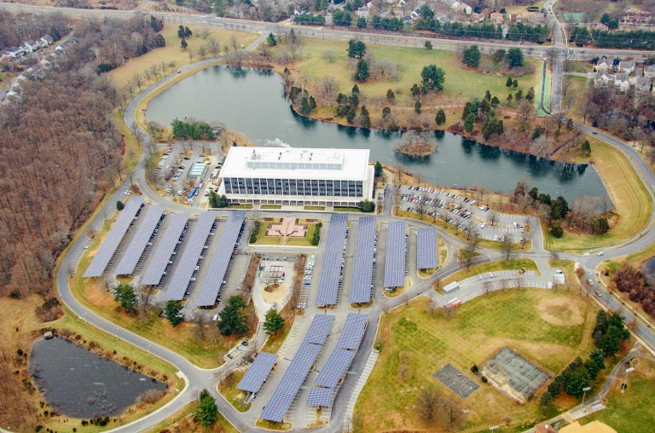
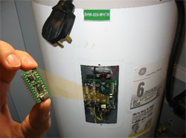
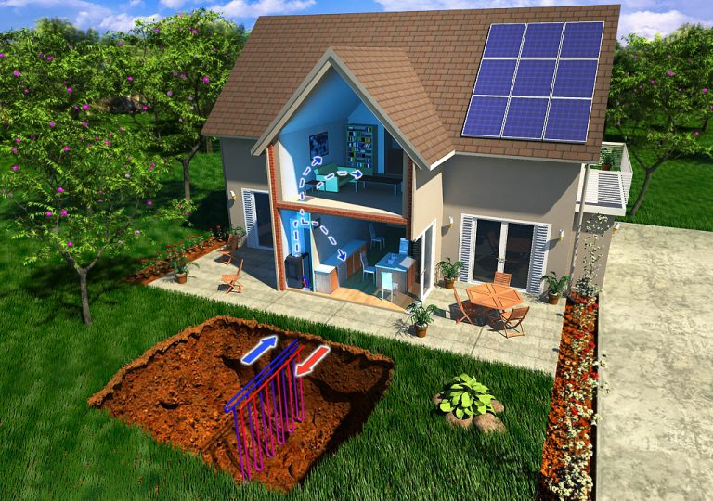
Rodney Sobin Senior Program Director National Association of State Energy Officials NASEO Annual Meeting Manhattan Beach, CA September 16, 2019
NASEO-NARUC
State Working Group Roundtable and Workshop

Slide 2
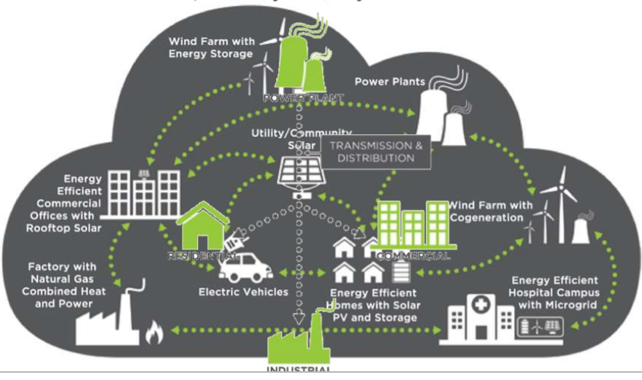
Grid-Interactive Efficient Building Opportunities
Advancing technologies open opportunities for more flexible building/facility load management:
Reduce costs, enhance resilience, reduce emissions
Reduce peaks, moderate ramp rates, provide grid services
Enhance energy efficiency
Integrate distributed and renewable resources
How can we optimize facility interactions with the grid?
How can states fashion policies, programs, and regulations to advance such optimization through GEB?
What are roles for states, facility operators, utilities, product and service providers, and others?
Notes:
Growing opportunities for distributed energy resources (DERs) and managing loads and technologies advance—EE; DG (RE, fossil, CHP); DR and load management; storage, also EVs.
Challenges to grid management as DERs and utility scale renewables increase
“Non-wires solutions” as alternatives to conventional distribution system upgrades
Technological opportunities and challenges to optimizing building-grid(-EV) interactions
However, need price/economic signals for both facility owners and utilities to implement GEB – monetize benefits
Policies, programs, regulations (including rate structures)
Time-of-use, peak, critical peak charges; ancillary services (voltage, frequency support)
Value of resilience—power quality, facility operation during brownout and outage; reduced grid stresses
Roles and opportunities for ESCOs?

Slide 3
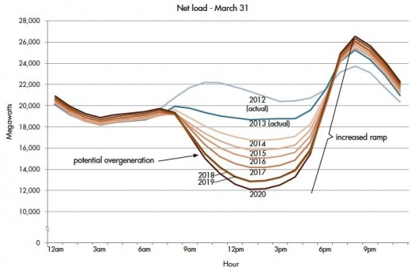
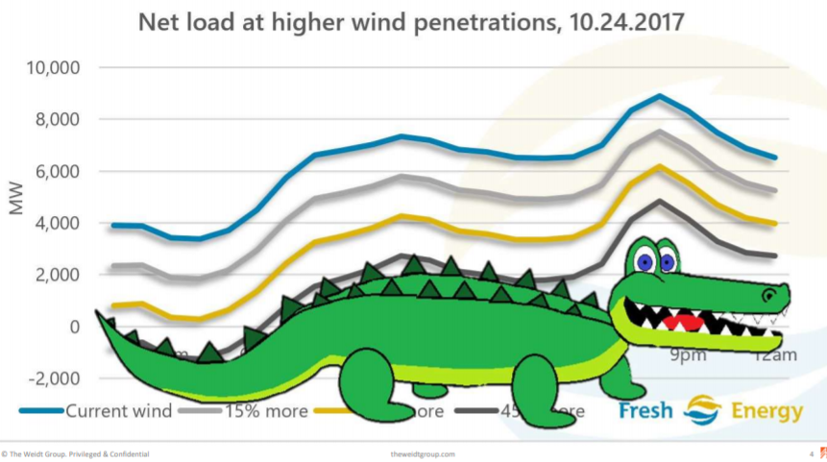
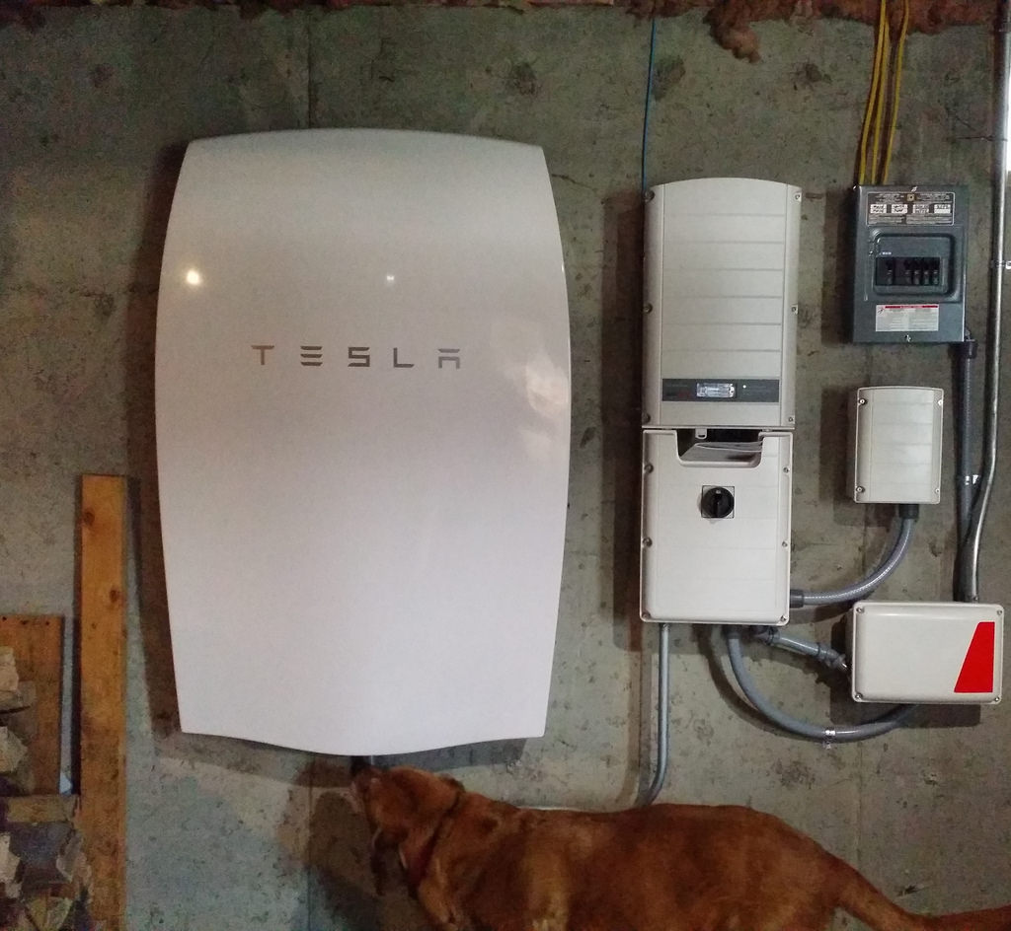
NASEO-NARUC Grid-Interactive Efficient Buildings Working Group
NASEO-NARUC GEB Working Group
Supported by U.S. DOE BTO
Inform states about GEB technologies and applications
Identify opportunities and impediments
Non-technical and technical
Identify and express state priorities, concerns, interests
Recognize temporal and locational value of EE and other DERs
Enhance energy system reliability, resilience, and affordability
Inform state planning, policy, regulations, and programs
Webinars, briefing papers, calls
Advance potential roadmaps and pilots
National Lab technical assistance
TODAY: Roundtable and Workshop at NASEO Annual Meeting
September 16, 2019

Slide 4
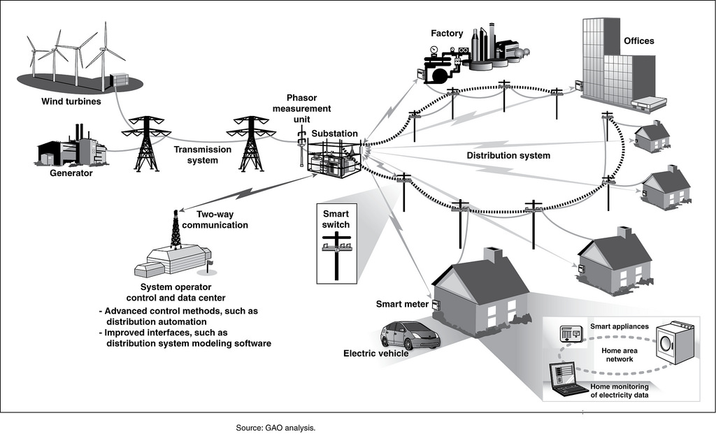
NASEO-NARUC Grid-Interactive Efficient Buildings Working Group
Working Group co-chairs:
Kaci Radcliffe, Oregon Dept. of Energy
Hanna Terwilliger, Minnesota PUC staff
Working Group states:
Colorado New Jersey
Connecticut New York
Florida Oregon
Hawaii South Carolina
Massachusetts Tennessee
Michigan Virginia
Minnesota Wisconsin

Slide 5
ACEEE GEB Utility & Program Administrator Working Group
Utilities are excited about GEB grid benefits, but currently lack the resources, administrative structures, and experience to properly value efficiency and grid services.
Local and state governments can support and foster the development of GEB programs through collaboration with utilities, regulators, and stakeholders to enact policies and regulations to value and include GEB in customer programs and integrated resource plans.
Data management is still a major challenge for utilities, which involves AMI installation, data collection and analysis, DER monitoring and control, and provision of actionable information to customers.
Notes:
Additional notes:
We’re finding much of this is due to internal silos between the energy efficiency program staff and the demand response/grid-services program staff, as well as planning and operations staff. In some cases, there is insufficient internal or regulatory motivation to pursue integration. In addition there isn’t a standardized method of valuing grid services from buildings, though groups like NBI and their GridOptimal Buildings Initiative are trying to develop one through pilot projects.
There appear to be opportunities for policies, mandates, eligibility requirements, and incentives to be restructured to encourage grid management alongside customer energy savings. Including GEBs in the IRP process and finding ways for utilities to collaborate with regulators on GEBs are two additional ways to help enable GEB programs.
When it comes to data and technology, utilities are undergoing a major cultural shift, and will need strong support from IT department. For example, advanced metering infrastructure (AMI) produces a lot of data, which requires data science and analytical tools and skills. Implementing and using a Distributed Energy Resource Management System (DERMS) to respond to price signals and manage the load also requires significant technical expertise.

Slide 6
NASEO-NARUC Grid-Interactive Efficient Buildings Working Group
https://naseo.org/issues/buildings/naseo-naruc-geb-working-group
Questions/inquiries:
Rodney Sobin rsobin@naseo.org and Maddie Koewler mkoewler@naseo.org
Danielle Sass Byrnett dbyrnett@naruc.org

